Slide 1
Real-Time Budget & Performance Tracking
ARGHYADIP PANDEY & ARITRA CHAKRABORTY

Slide 2
INTRODUCTION
This project aims to develop a budget report and an automated master data system for management and visualization. Through the system, the report will be capable of reporting employee allocation by project, total budget, delta variations, monthly billing cycles, and the remaining budget ratio. The project aims at simplifying the monitoring of the budget by developing a master data sheet that contains the total budget, money spent, and balance of a company. The data sheet will benefit from conditional formatting to alter the rows' background colors to red for less than 10% balance and yellow when the balance is less than 25%.

Slide 3
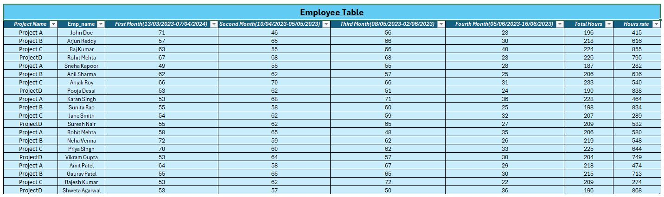
IBM

Slide 4
Employee Work-Hour and Budget Analysis of IBM
1. Employee Work-Hour Table Analysis
Projects & Employees: Tracks employee work hours across four projects (A, B, C, and D) over 14 weeks.
Weekly & Monthly Work Hours: Each employee’s work hours are recorded weekly and totaled monthly.
Total Hours & Hourly Rate: Used to determine total labor cost per project.
2. Budget Table Analysis
Employee Count per Project: Each project has 5 employees.
Monthly Burn Rate: Labor costs are tracked per month.
Project-Wise Budget: Fixed at ₹5,000,000 per project.
Total Burnt & Remaining Budget:
Project A: Burnt ₹2,292,525 (54% budget remaining).
Project B: Burnt ₹3,534,432 (29% budget remaining).
Project C: Burnt ₹2,856,996 (43% budget remaining).
Project D: Burnt ₹3,927,800 (21% budget remaining).
3. Key Insights
Project D has the highest spending and only 21% budget left, indicating possible overspending.
Project B has a high burn rate, with only 29% budget left.
Project A is the most cost-efficient, with 54% budget remaining.
Project C has moderate spending, with 43% of the budget left.
4. Recommendations
Monitor Project D & Project B to prevent budget overruns.
Project A has a surplus budget – consider reallocation or optimization.
Redistribute workforce/resources to balance workload and efficiency.

Slide 5
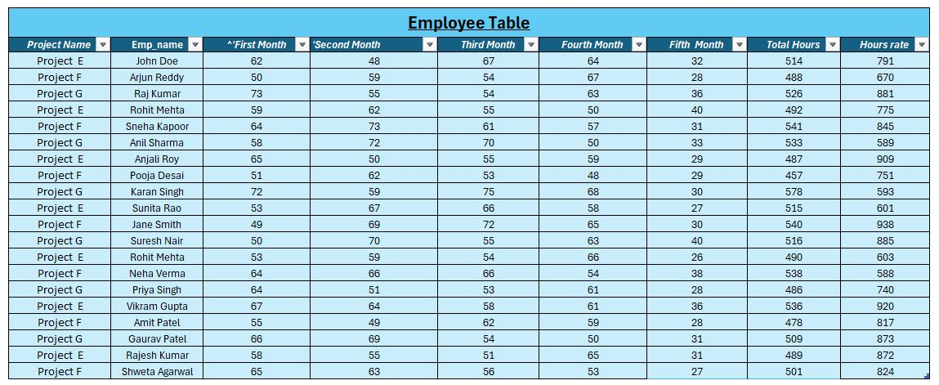
IQVIA

Slide 6
Employee Work-Hour and Budget Analysis of IQVIA
1. Employee Work-Hour Table Analysis
Employee Count:
Project E: 7 employees
Project F: 7 employees
Project G: 6 employees
Work Hours:
Recorded weekly, aggregated monthly.
Costs calculated based on hourly rates.
2. Budget Table Analysis
Burn Rate & Remaining Budget:
Project E: ₹10,241,712 spent, ₹758,288 left (7%).
Project F: ₹10,197,741 spent, ₹802,259 left (7%).
Project G: ₹7,630,553 spent, ₹3,369,447 left (31%).
3. Key Insights
Projects E & F are close to budget exhaustion (only 7% left).
Project G is more cost-efficient (31% of budget remaining).
Spending was highest in the first four months, then declined.
Projects E & F have the highest burn rate – risk of overspending.
Project G's lower workforce and expenditure contribute to better budget retention.
4. Recommendations
Monitor Projects E & F to prevent overspending.
Optimize workforce allocation for efficiency.
Adopt Project G’s cost-efficiency strategies across other projects.
Reduce unnecessary expenses in Projects E & F.

Slide 7
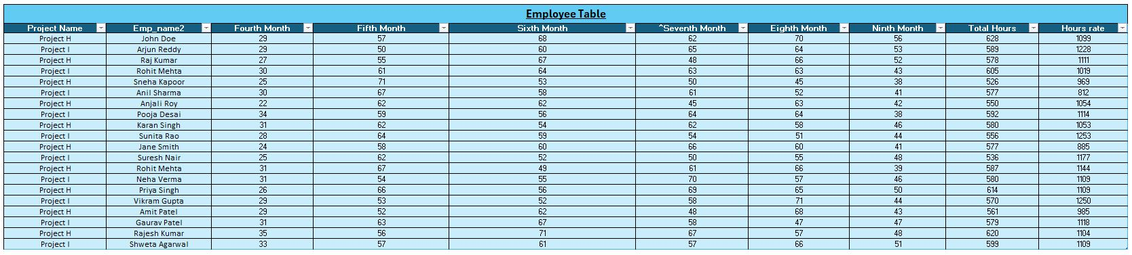
BAJAJ

Slide 8
Employee Work-Hour and Budget Analysis of BAJAJ
1. Employee Table Analysis
Employee Count:
Project H: 10 employees
Project I: 10 employees
Work Hours:
Recorded weekly and aggregated monthly.
The total hours worked for each project:
Project H: 6,280 hours
Project I: 5,890 hours
Employees worked consistently across all tracked weeks.
2. Budget Table Analysis
Total Budget per Project: ₹44,600,000
Burn Rate & Remaining Budget:
Project H: ₹32,989,794 spent, ₹11,610,206 left (26% remaining).
Project I: ₹34,898,491 spent, ₹9,701,509 left (22% remaining).
3. Key Insights
Project I is burning through its budget faster than Project H.
Project H has slightly better budget retention (26% remaining vs. 22% in Project I).
Overall, both projects are nearing budget exhaustion, requiring close monitoring.
Spending is highest in months 4 to 7, indicating a peak workload during this period.
Hourly rates and work-hour distribution suggest potential inefficiencies.
4.Recommendations
Monitor Project I closely to prevent premature budget depletion.
Optimize workforce allocation to ensure hours are utilized efficiently.
Adopt cost-saving strategies similar to Project H for better budget retention.
Reduce unnecessary expenses and streamline processes to maintain financial control

Slide 9
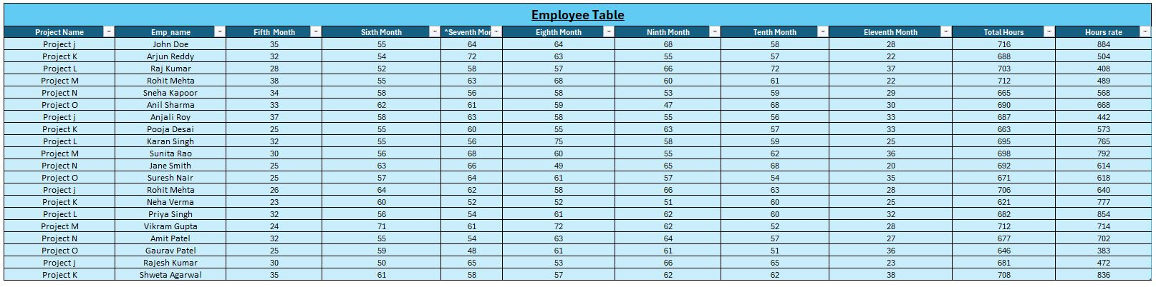
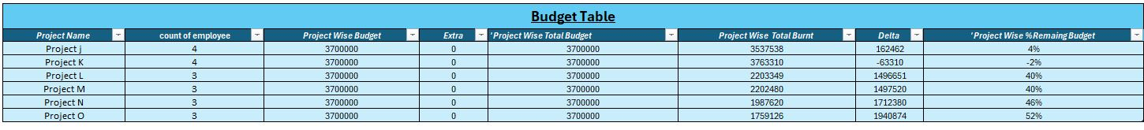
RI

Slide 10
Employee Work-Hour and Budget Analysis of RI
1. Employee Table Analysis
Employee Count:
Project J: 4 employees
Project K: 4 employees
Project L, M, N, O: 3 employees each
Work Hours:
Recorded weekly, aggregated across multiple months.
Variation in hours worked per employee across projects.
2. Budget Table Analysis
Burn Rate & Remaining Budget:
Project J: ₹3,537,538 spent, ₹162,462 left (4% remaining).
Project K: Overspent by ₹63,310, meaning costs exceeded the budget by 2%.
Project L & M: ₹2,203,349 and ₹2,202,480 spent, with 40% budget remaining.
Project N: ₹1,987,620 spent, 46% budget remaining.
Project O: ₹1,759,126 spent, 52% budget remaining.
3. Key Insights
Projects J & K are at critical budget exhaustion levels (4% and overspent by 2%, respectively).
Projects L, M, N, and O have significant budget retention, with 40-52% remaining.
Project K is at risk of overspending and requires immediate cost containment.
Spending is highest in months 6-8, after which a slight decline is visible.
Lower employee count (Projects L, M, N, O) contributes to better budget retention.
4. Recommendations
Immediate Cost Control for Project K to prevent further budget overrun.
Monitor Projects J & K Closely to avoid unnecessary spending.
Reallocate Budget Strategies from Projects O & N (52% & 46% remaining) to J & K.
Optimize Workforce Allocation – Project J & K may require streamlined workforce distribution.
Analyze High Spending Months to identify excessive cost factors and optimize expenses.

Slide 11
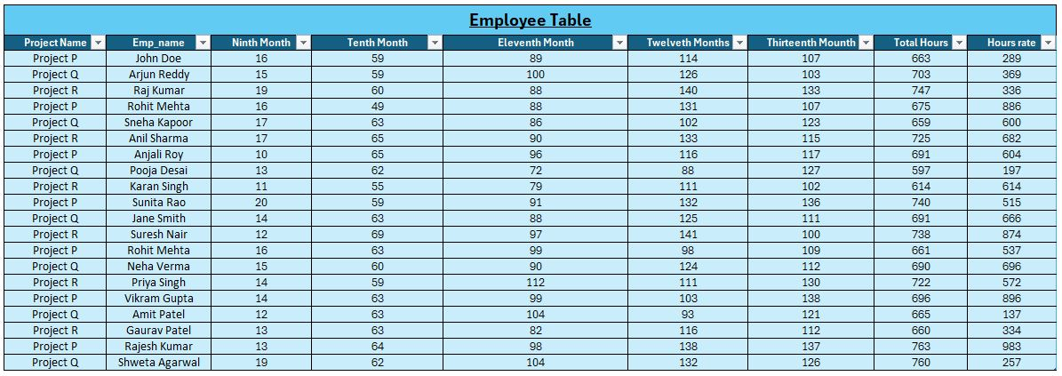
CTC

Slide 12
Employee Work-Hour and Budget Analysis of CTC
1. Employee Analysis
Employee Count:
Project P: 7 employees.
Project Q: 7 employees.
Project R: 6 employees.
Weekly Work Hour Trends:
Work hours are logged weekly over 16 weeks (from Nov 2023 to March 2024).
Employees generally work 10-40 hours per week, with fluctuations per project.
Peak work hours observed in the Eleventh Month (January 2024) across all projects.
Project R has fewer employees but relatively high weekly work hours.
2. Budget Analysis
Burn Rate & Remaining Budget:
Project P: Spent: ₹14,182,770, Remaining: ₹1,697,230 (11% budget left), High burn rate, nearing depletion.
Project Q: Spent: ₹9,016,878, Remaining: ₹6,863,122 (43% budget left), Balanced spending with good remaining funds.
Project R: Spent: ₹9,012,340, Remaining: ₹6,867,660 (43% budget left), Similar trend as Project Q, maintaining budget control.
3. Key Insights & Risk Areas
Projects Q & R are within budget, with 43% of funds still available.
Project P is at risk, with only 11% of the budget left, requiring urgent cost optimization.
January 2024 saw the highest spending across projects, indicating a possible overutilization of resources in that period.
Project R has fewer employees but maintains a comparable budget burn rate to Project Q, indicating higher individual employee costs or overtime.
4. Recommendations
Immediate Budget Monitoring for Project P – Ensure that the remaining funds cover essential tasks.
Cost Optimization Strategies for Project P – Redistribute work or reduce overtime to avoid budget overrun.
Utilize Surplus Budgets from Projects Q & R – If feasible, allocate some remaining funds towards Project P.
Review January 2024 Spending Trends – Identify cost spikes and address inefficiencies in that period.
Reassess Employee Workload in Project R – Since it has fewer employees, similar spending, overtime, and compensation policies need review.

Slide 13
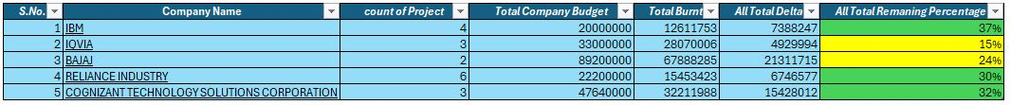
MASTER DATA SHEET

Slide 14
CONCLUSION
The dataset provides company budgets, burnt amounts, remaining balances, and their percentages. However, it lacks employee allocation and monthly billing data, which must be integrated for a complete budget report. The remaining budget percentages indicate that IQVIA (15%) is in a warning zone (yellow), and Bajaj (24%) is also approaching a critical threshold. To automate the master data, conditional formatting should be applied: rows turn red if remaining funds fall below 10%, yellow if below 25%, and green above 25%. Currently, no company is in the critical (<10%) zone, but IQVIA is close and should be monitored. To enhance reporting, employee allocation per project and monthly billing trends should be added to track real-time budget utilization effectively. Automating these insights with dynamic visualization in Excel or Power BI will help in better decision-making and financial tracking.

Slide 15
THANK YOU

